Slide 1

SMART ULTRASONIC BLIND STICK
Under guidance of
Mr. Gopalakrishnan,
INFORMATION TECHNOLOGY,
BIT,
Sathy.
Student 1 (VASANTH S 2021UIT1065)
Student 2 (PRAVIN KRISHNA K 2021UIT1135)

Slide 2

Abstract
There are more than 12 millions of peoples are struggling to live their everyday life eye blindness. Permanent eye blindness is a major problem for humans. To rectify this problem we have made a smart ultrasonic blind stick which will be definitely useful for blind peoples, this blind stick not like ordinary blind stick rather this uses an ultrasonic sensor working preciously with the help of Arduino. This is smart as well as cheap invention so that it’s not only for rich peoples will be applicable for middle and low class peoples also. The ultra-sonic sensor detects the obstacles facing in front of people and triggers them with a high pitch beep sound with small amount of vibration occurs in the stick. So, that the person could recognize that there is an obstacle in front of him. This technology will help many people who is suffering form permanent or partial blindness.

Slide 3
Problem Statement Addressed
A suitable walker gadget for peoples who is suffering from eye blindness. In INDIA more than 400+ accidents held everyday this is hazard for both drivers and blind people in publics.

Slide 4
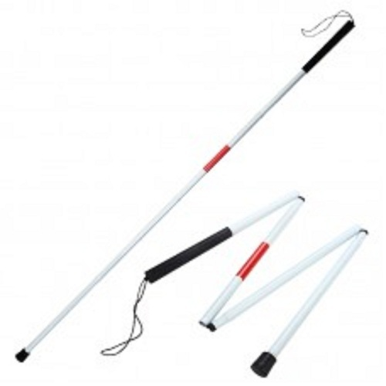
Existing Solution to the Problem Addressed
To rectify the above problem peoples use blind stick to find the obstacles if front of them. But although using blind stick it is still a major problem for blind peoples.

Slide 5

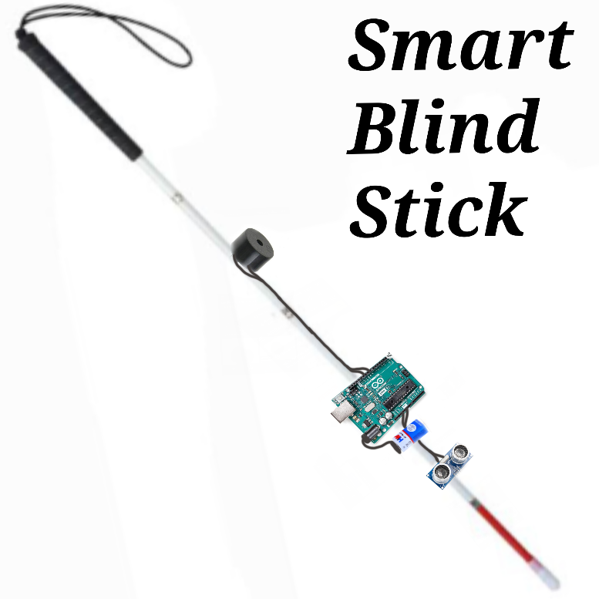
Proposed Solution to the Problem Addressed
Instead of using an ordinary blind stick we have proposed a smart ultrasonic blind stick which is a intelligent blind stick that alerts the people using it if there is any physical obstacles in front of them.

Slide 6
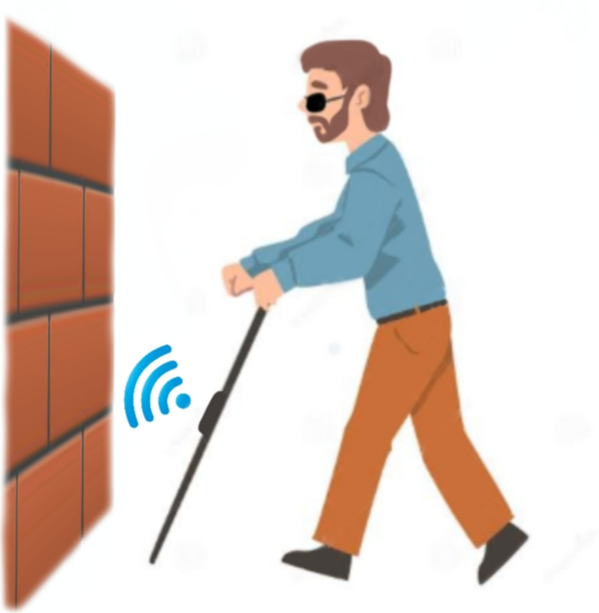
Project Work Plan

Slide 7
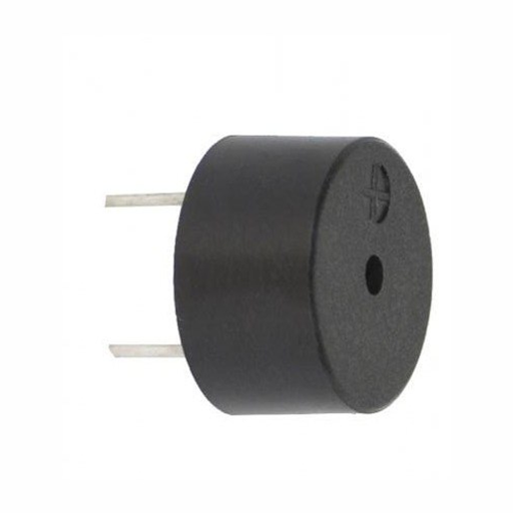
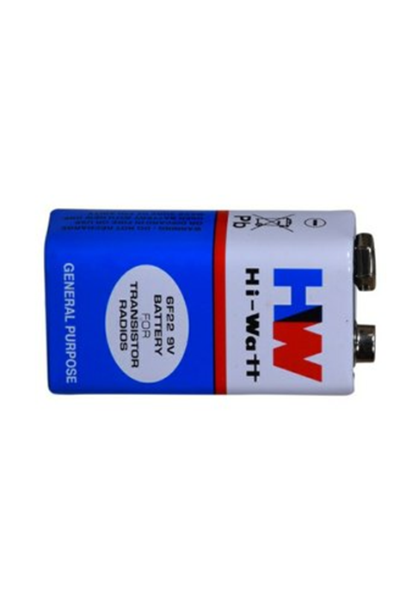
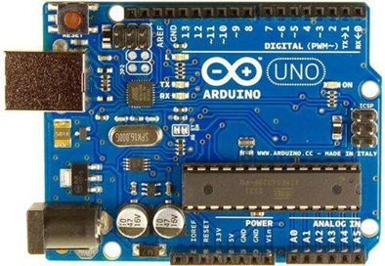

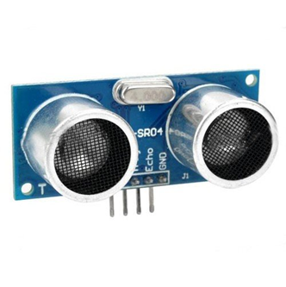
Block Diagram and/or Circuit Diagram

Slide 8

Flow Chart
OBJECT DETECTED FROM ULTRA SONIC SENSOR
PASSES SIGNAL TO ARDUNIO DISTANCE OF THE OBJECT IS MEASURED BY THE ARDUINO
ARDUINO ACTIVATES THE BUZZER.
THE PERSON COULD RECOGNIZE THAT THERE IS OBSTACLE IS IN FRONT OF HIM.
THE BUZZER GIVES HIGH PITCH BEEP SOUND

Slide 9
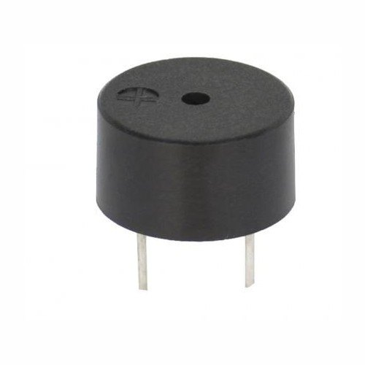



Technology stack & use case

Slide 10
Prototype & Sample Output

Slide 11

Analysis of Results & Discussions
smart ultrasonic blind stick which will be definitely useful for blind peoples, this blind stick not like ordinary blind stick rather this uses an ultrasonic sensor working preciously with the help of Arduino. This is smart as well as cheap invention so that it’s not only for rich peoples will be applicable for middle and low class peoples also. The ultra-sonic sensor detects the obstacles facing in front of people and triggers them with a high pitch beep sound with small amount of vibration occurs in the stick. So, that the person could recognize that there is an obstacle in front of him. This technology will help many people who is suffering form permanent or partial blindness.

Slide 12
Cost Benefit Analysis (List of Components / Service Used)
S.No | Component Name |  | Unit Cost | Total Cost
1. | Arduino |  | 500 | 500
2. | HW battery |  | 20 | 20
3. | Ultra sonic sensor |  | 50 | 50
4. | Adessive or Glue |  | 20 | 20
5. | Buzzer |  | 30 | 30

Slide 13

References
“Getting started with Arduino” – Pypower projects (YOUTUBE).

